Slide 1
Test Automation Solution

Slide 2
Contents
Executive Summary
Automation – PRIME Applications
Automation approach
Tools & Framework
Automation Plan
Status update
Demo
Appendix

Slide 3
Executive Summary
Here we talk about the Automation Solution and benefits that can be reaped in Long run
Challenges
What EnterCard will accomplish?
Benefits of Automation
Without Automation
Enterprise-level standardization
Early Automation by getting involved from Requirement stage
Repetitive testing
Control testing costs & Test more efficiently
Test more often. Automated tests can be run for every change
Higher consumption of Manual efforts
Shift Left Testing approach
Automated suite execution after every build deployment
Increased Execution cycle
Enabling Speed to Market and productivity improvements
Reduced Maintenance cost
Manual smoke test
Multi-browser support
Up-Skilling of Testers as Automation Engineers
No Build verification (CI)
Reusability with more test coverage

Slide 4
Automation – PRIME Applications
We have created Test Automation solution of Prime application
Application Scope As follows :-
Prime Templates
Prime Parameters
Prime Job Admin
Application Manager
Customer Service
Manual Transactions
Transaction Management
Outgoing File - Embossing and Electronic Statement
Incoming Transaction File

Slide 5
Automation Approach
Automation Test Planning
Preparation
Automation Development
Automation Test Execution
Completion
Define Automation strategy
Workflow design for identified scope
Develop Script using Selenium Framework
Dry Run of test scripts and Demo
Test Completion Report
Set up automation tools
Mapping of workflows with test scenarios
Identify scripts for TestNG execution
Create test Suite scripts with common functionality for execution
Creation of Page Class and of Utility class for the defined workflow.
Validate scripts for given release/project.
Prepare detailed Test Approach
Develop Common Classes, function and Utility
Prepare execution schedule using JENKINS
Prepare Dry Run Test Case
Review of designed workflows
Test Result generation and verification
Dry Run and Demo of designed test case
Automation strategy
Test Plan
Workflow design base lined and documented in detailed steps
Test Results with screenshots for executed workflows
Traceability Matrix
Test Scripts
Test Results with Screenshots
Test Completion report
Testing Phase
Activity
Deliverables

Slide 6
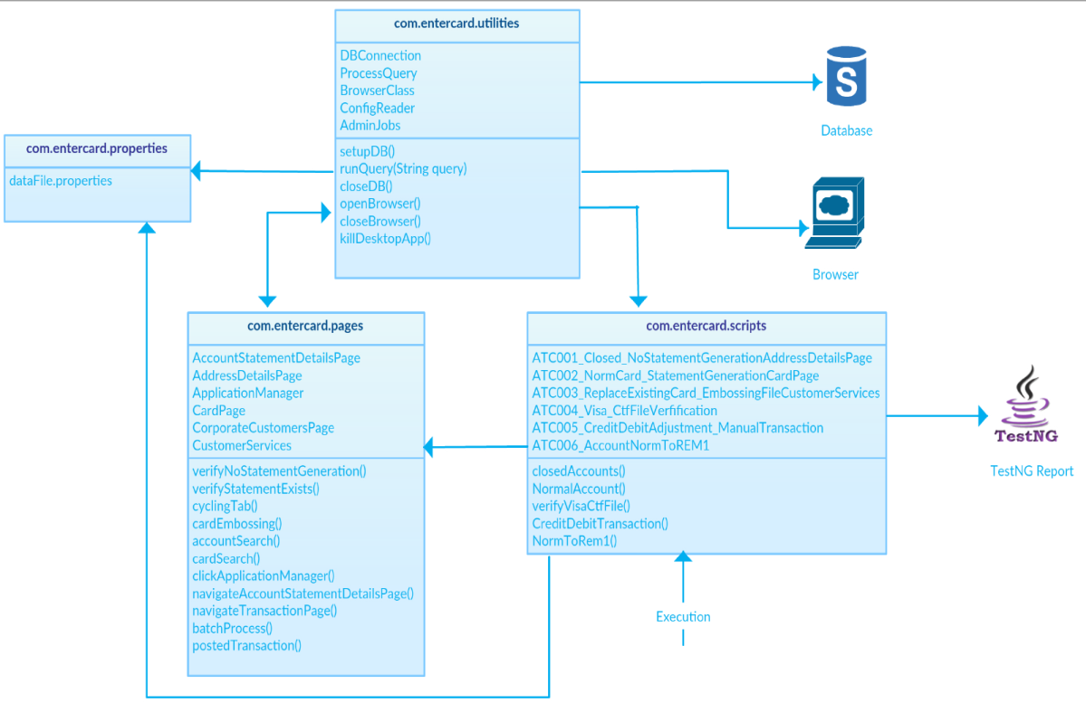
Automation Tools & Framework
Automation Tool
Selenium – Web Driver
Framework and key benefit
Page Object Model
Page Object Patten says operations and flows in the UI should be separated from verification.
Code becomes less and optimized because of the reusable page methods in the POM classes.

Slide 7
Automation Plan
Feasibility Study of PRIME Application for Automation
Tool Identification and Framework Creation
Implement PRIME Application Automation
Feasibility Study of SOA Automation need
Design /Reuse Framework for SOA Testing
Implement Automation for SOA Testing
Feasibility Study of Sales Force Application
Design /Reuse Framework for Sales Force
Implement Automation for Sales Force
May-17
Aug-17
Aug/Sept-17
Oct/Nov-17
Identify Next Set of Application and keep developing the Automation solution
Jun/Jul/Aug-17
Aug/Sept-17
Sept-17
Nov/Dec-17
May-17
Smoke Test Suite will comprise of the prime regression testcases and SOA which will be then integrated with Continuous Integration process
Application Stack for Automation
PRIME
SOA Services
Sales Force
SAS JOB
NetBank
Mobile APP

Slide 8
Automation Status Update
Sr No | Module / Functionality | Type | Test Cases | Completed | Pending | Blocked
1 | All | End to End | 23 | 16 |  | 7
 |  | Total | 23 | 16 |  | 7
1 | Transaction Management | Regression | 16 | 16
2 | Security | Regression | 3 | 3
3 | Customer Services | Regression | 226 | 130 | 45 | 51
6 | Application Manager | Regression | 42 | 42
7 | Card Production | Regression | 10 | 2 |  | 8
8 | Transaction Processing | Regression | 27 |  |  | 27
 |  | Total | 324 | 193 | 45 | 86
Challenges in Test Automation –
1. Setup of Selenium Automation environment on remote machine (offline mode)
2. Configuration of third party tools (AutoIt and Winium) for standalone application
3. Finding possible solution for AUT(Application Under Test) browser compatibility issues across modules
4. Developing Page Object model framework fitting according to the needs of AUT
5. Identification and building reusable functions of AUT
6. Handling various files in remote servers using IO streams /external files
7. Aligning multiple Web and standalone Tests in a Test Suite

Slide 9
Demo
Short Demo
Happy path Flow demo
See the result
Conclude the test and show reporting
Detailed Demo :
Selenium Web Driver Explanation
POM Explanation
Implementation Explanation
Question and answer.

Slide 10
Appendix

Slide 11
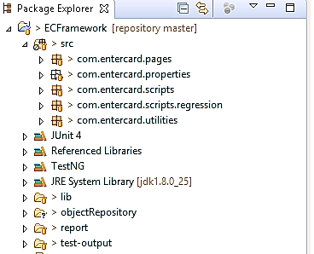
Selenium WebDriver- Package Explorer view

Slide 12
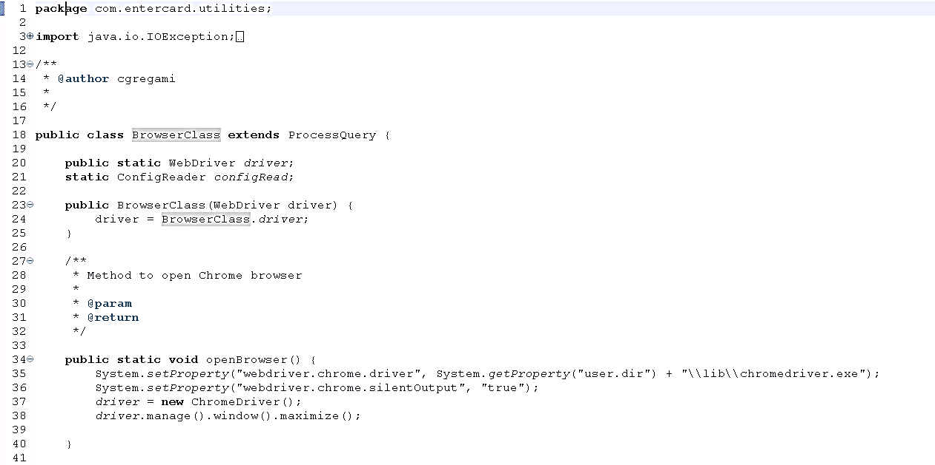
Selenium WebDriver – Script View

Slide 13
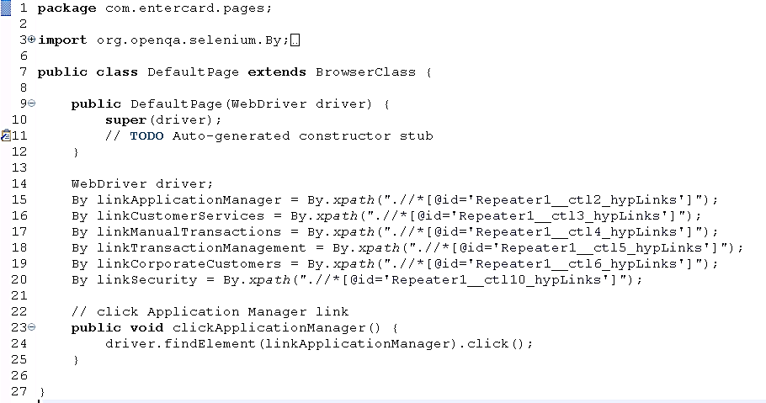
Selenium WebDriver- Page View

Slide 14
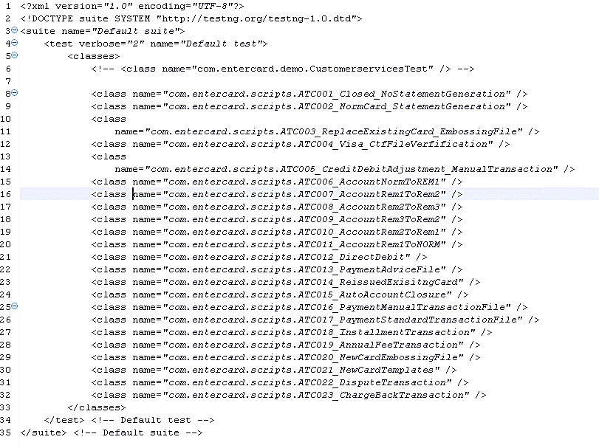
Automation Screenshot – TestNG suite

Slide 15
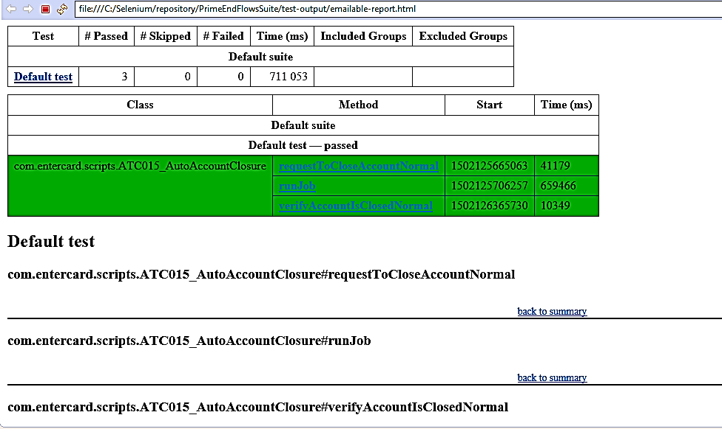
Selenium WebDriver – TestNG report

Slide 16
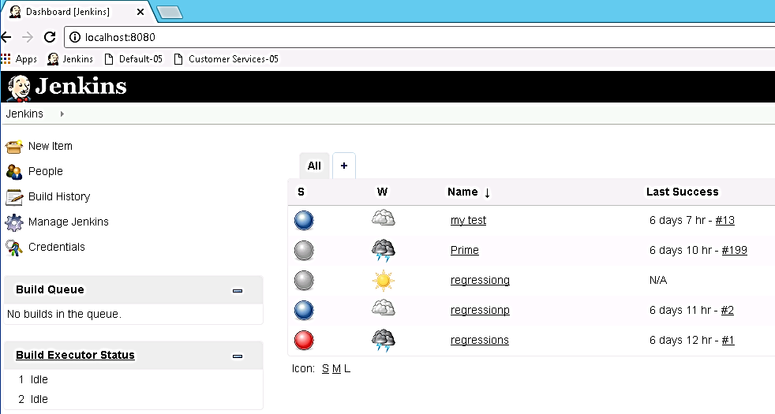
Selenium WebDriver – Jenkins dashboard

Slide 17
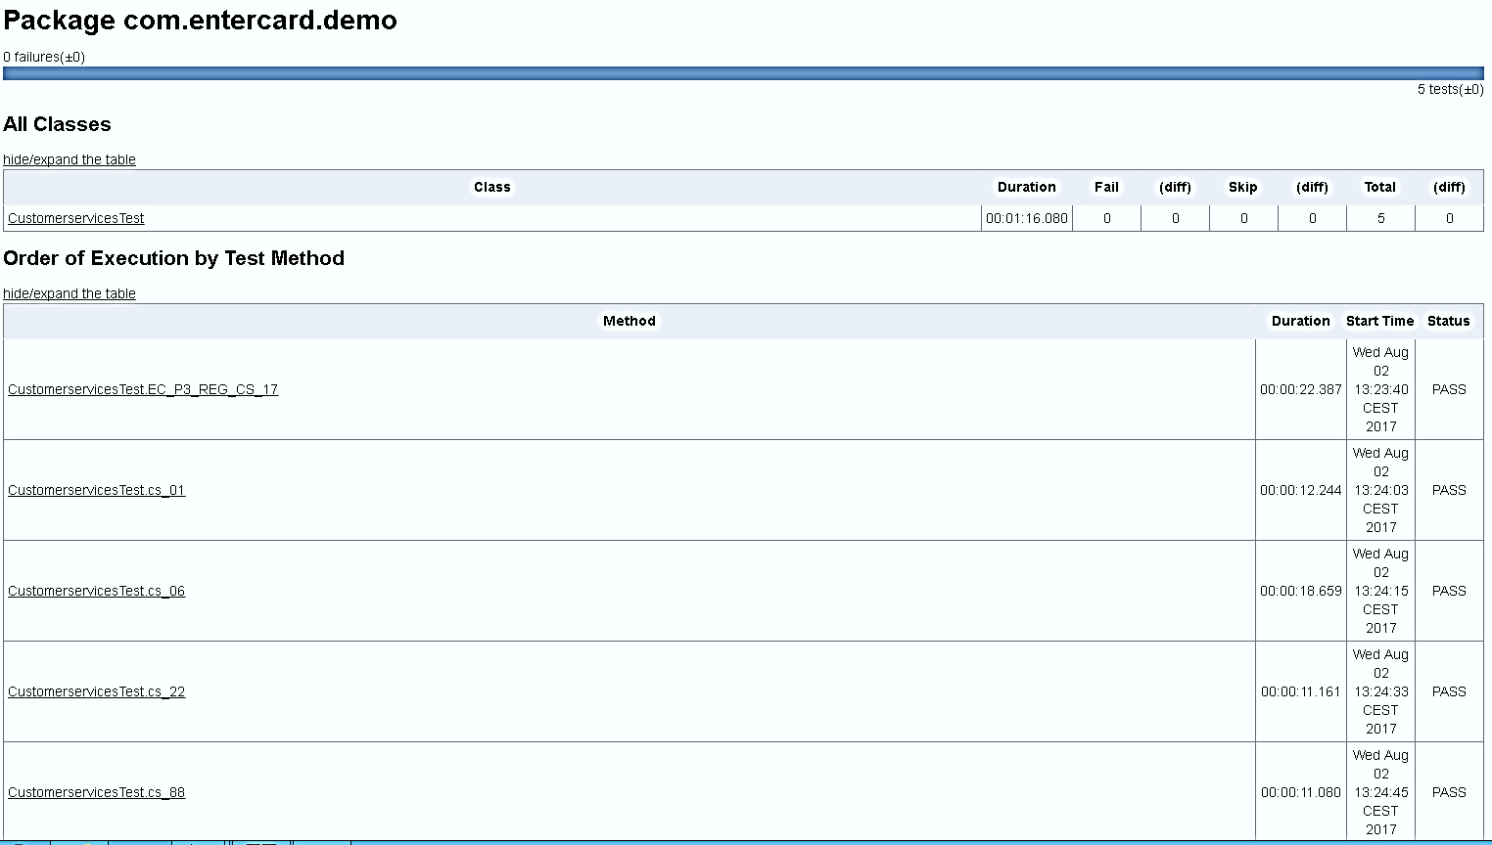
Selenium WebDriver – Jenkins TestNG Result

Slide 18
Project Scope – Test Case wise.
For test automation of End To End testing we have considered the below mentioned 22 test scenarios which will give 45% coverage for the 9 modules considered in scope :-
Verify that the newly created card details are as per the Templates codes defined, considering 18 products in scope and also check for the profiles.
Verify the embossing file layout when a new card is created.
Verify the embossing file when an existing card is Renewed/Replace/Reissued
Verify the posting of (Sales) transaction to a card and verifying it in Customer Services /Transaction Management
Verify the posting of CR / DB Adjustment transactions to a card and verifying it in Customer Services /Transaction Management
Verify the fee transactions posted to an account based on the profiles defined in Global Parameters considering two products in scope .
Verify the posting of payments through Standard Transaction file / Manual Transactions.
Verify the Statement generation for a NORM card and check for the layout of Electronic Statement file.
Verify the contents of transactions like Fee, Sales , Adjustments, Payments & Interest in the Statement generated.
Verify that the statement is not generated for Close / DCAC accounts.
Verify that the Account is moved to collection (i.e. NORM --> REM1) for missed payments
Verify that the Account is moved to collection (i.e. REM1 --> REM2) for missed payments
Verify that the Account is moved to collection (i.e. REM2 --> REM3) for missed payments
Verify that the Account is moved from collection (i.e. REM3 --> REM2) when done payments.
Verify that the Account is moved from collection (i.e. REM2 --> REM1) when done payments.
Verify that the Account is moved from collection (i.e. REM1 --> NORM) when done payments
Verify the flow of making a dispute transactions.(i.e. chargeback)
Verify the Installment Transaction creation through Application and complete flow up to closure.
Verify the functionality of Auto Account closure
Verify the Direct Debit functionality.
Verify the Balance Transfer functionality.
Verify the functionality of Auto Write off.
For test automation of Regression Test cases we have considered 324 scripts as a scope which gives 100% coverage of all 9 modules.

Slide 19
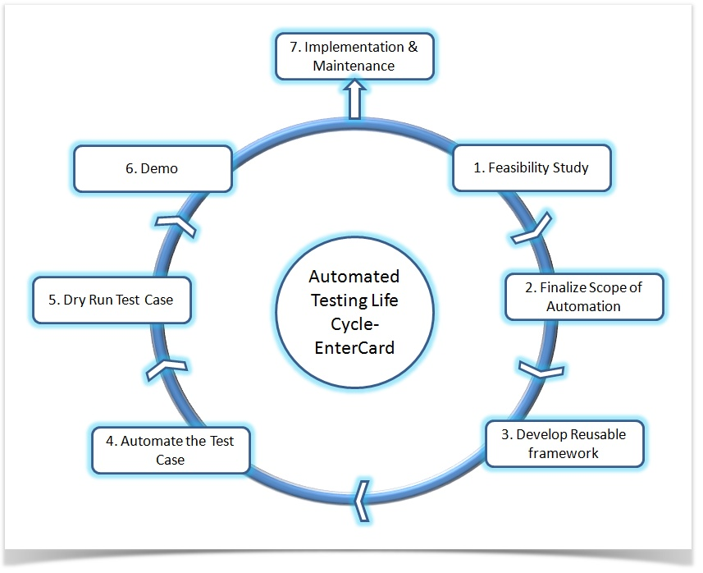
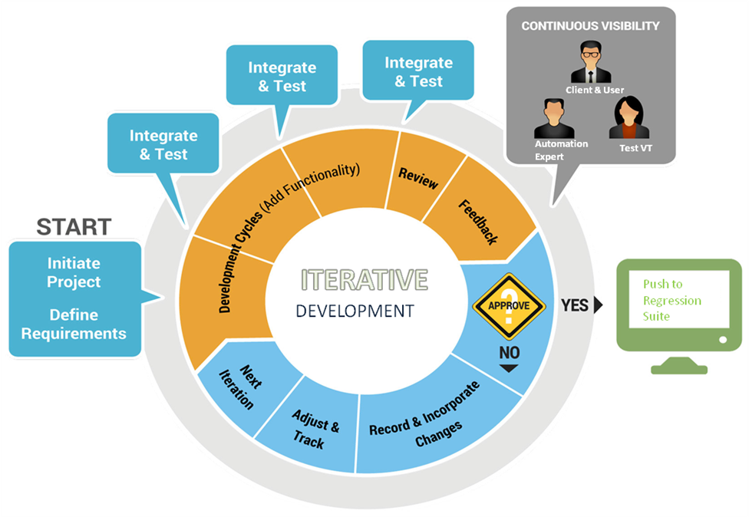
Automation Strategy
Automation Strategy
Itetrative development.
Feedback based development.

Slide 20
Thank You
Neither submission by Capgemini nor your acceptance of this proposal, in whole or in part, constitutes acceptance by Capgemini of any contractual terms contained in your Request for Proposal, if any, and shall not form a binding agreement between the parties. Such an agreement shall only exist upon the execution of a mutually acceptable contract by both parties. Except as otherwise set forth in such a contract, Capgemini makes no representations or warranties to you in relation to the accuracy or completeness of any information or data provided in the proposal. The term “Capgemini” appearing elsewhere in this proposal may refer to Capgemini, or to one or more of the subsidiaries or affiliates of Capgemini.
Copyright© 2013. Capgemini.

